Slide 1
ENSE 477
Scrum Report-Out
t2ee
Zuoxiu Xing
2020/01/14

Slide 2

Project deats
Remind me what you are doing
  Web portal that utilizes OpenStack API and services
  Self-service VM deployment platform
Notes:
I am trying to make a self-service virtual machine deployment platform which is a web portal that utilize openstack api and services

Slide 3

Progress review
How did you address previous scrum comments?
  Purpose
  Complexity
Notes:
There were mainly two comments about the project. The purpose: why I am making this and the complexity.

Slide 4
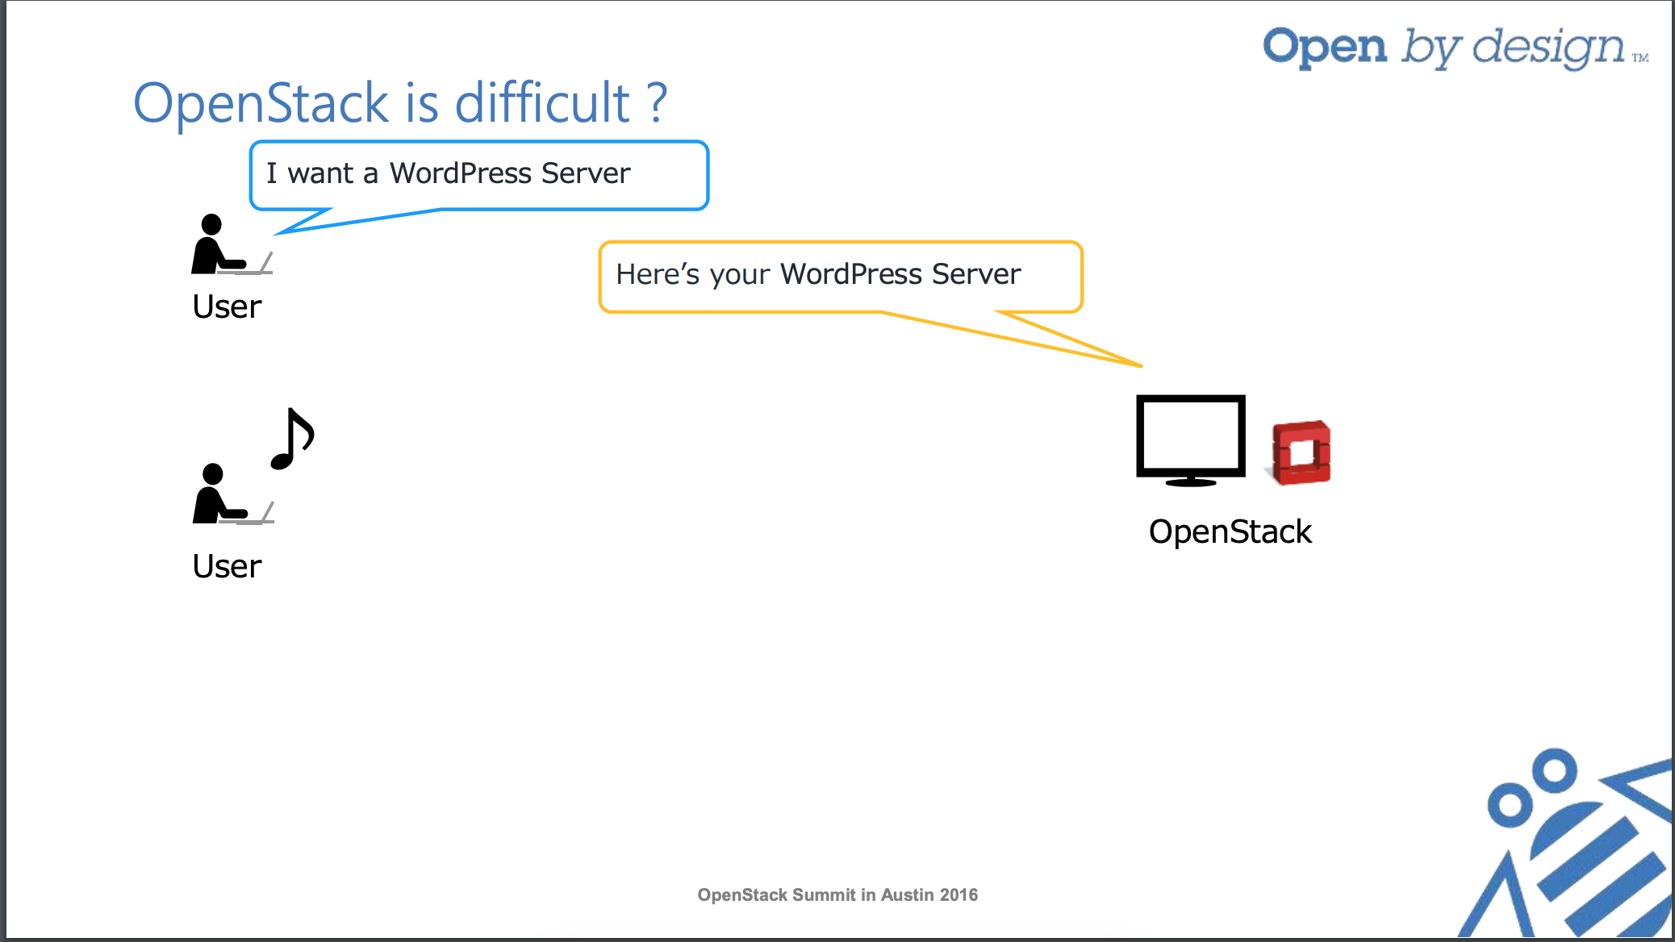
Build your own Web Portal using OpenStack APIs and Services OpenStack Summit in Austin 2016
Notes:
I found this keynote online and explains why I am building this very well.
This is what the user think openstack is doing

Slide 5
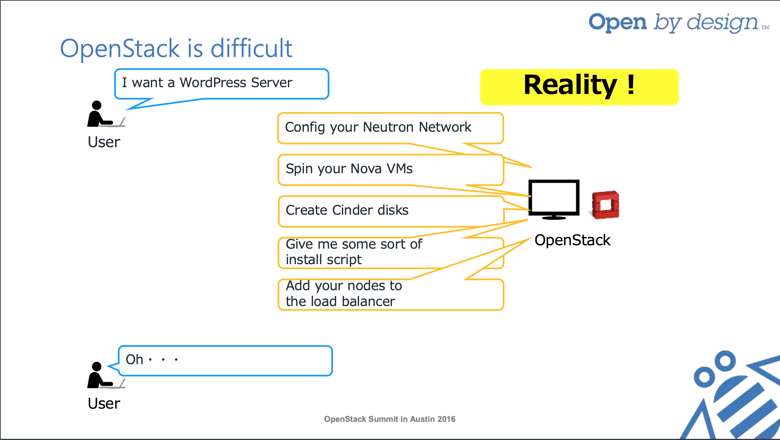
Build your own Web Portal using OpenStack APIs and Services OpenStack Summit in Austin 2016
Notes:
And this is the reality. There are lots of things to concern.

Slide 6
Build your own Web Portal using OpenStack APIs and Services OpenStack Summit in Austin 2016
Notes:
And this is what I want to accomplish for this project

Slide 7
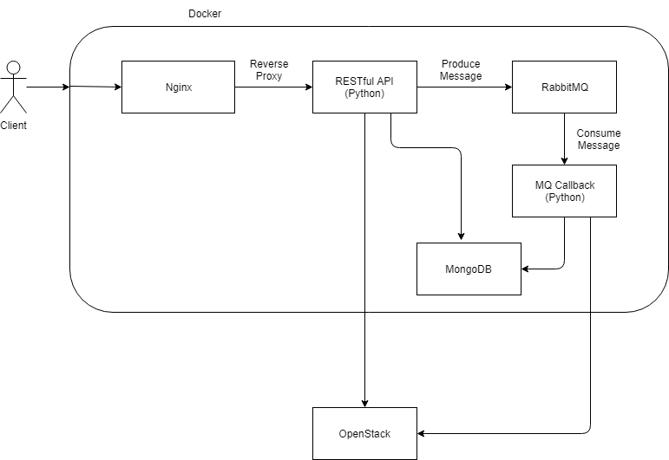
Block Diagram
Notes:
For the complexity. Here is the block diagram of my project.
Everything except openstack will be running in docker.
The Nginx will host front end interface and act as reverse proxy for backend RESTful api
The api will deal with the request and send some message to MQ. And there are MQ callback functions to deal with messages.
I added this RabbitMQ because some of the actions like creating virtual machines and creating templates takes time.
It is not a good idea to let user wait for the response.
Then there is a mongo DB to store all my customized data
At last, the python codes communicates with openstack to perform tasks

Slide 8
GitHub
GitHub

Slide 9

Group reflection
Do you feel you are on track?
  Yes
Do you feel there are barriers to your success (if any)?
  Nothing particular
Do you need any help going forward?
  All good for now
Any other questions or concerns?
  Testing
Notes:
How good the test is needed

Slide 10
Image refs
Show me what you got, https://pictures.abebooks.com/isbn/9781548899530-us-300.jpg
Patrick, https://imgflip.com/memetemplate/43274976/spongebob-patrick-nail-saw
Dilbert, http://4.bp.blogspot.com/-tVbJsudDNaw/T29WxQ0PHZI/AAAAAAAAABc/UlTwD2gkzA4/s1600/Dilbert%2520Software%2520Demo%5B1%5D.jpg
Pondering, https://imgflip.com/s/meme/Question-Rage-Face.jpg

